Slide 1
Project Title: Topic Modeling on Twitter Data
Mohammad Ayyaz Azeem 12520
Aftab ullah 11156

Slide 2
Steps in presentation
Topic Modeling
Data Accusation
LDA
Model Implementation
Code

Slide 3
Topic Modeling
Topic Modeling allows for us to efficiently analyze large volumes of text by clustering documents into topics.
A large amount of text data used is unlabeled

Slide 4
Topic Modeling
If we have unlabeled data, then we can attempt to “discover” labels.
In the case of text data, this means attempting to discover clusters of documents, grouped together by topic.

Slide 5
Topic Modeling
A very important idea to keep in mind here is that we don’t know the “correct” topic or “right answer!”
All we know is that the documents clustered together share similar topic ideas.
It is up to the user to identify what these topics represent.

Slide 6
Data Accusation
25911 tweets extracted with the #tag “Kashmir bleeds”

Slide 7
Latent Dirichlet Allocation (LDA)
Johann Dirichlet German Mathematics in 1800s who contributed widely to the field of modern mathematics.
There is a probability distribution named after him “Dirichlet Distribution”
LDA is based on this distribution
LDA was published in 2003 as a graphical model by David Blei, Andrew Ng, and Michael I. Jordan

Slide 8
Assumptions of LDA for Topic Modeling
Documents with similar topics use similar group of words
Latent topics can then be found by searching for groups of words that frequently occur together in documents across the corpus.

Slide 9
We can assume:
Assumptions:
Documents are probability distributions over latent topics
Topics themselves are probability distribution over words.

Slide 10
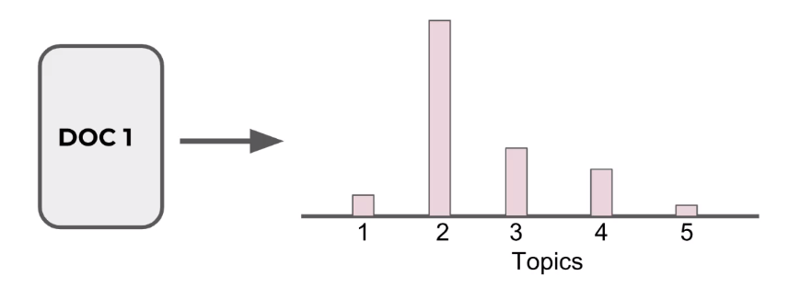
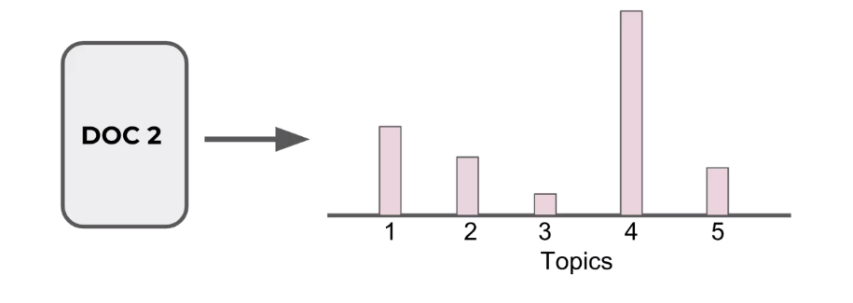
Documents are probability distributions over latent topics

Slide 11
Documents are probability distributions over latent topics

Slide 12
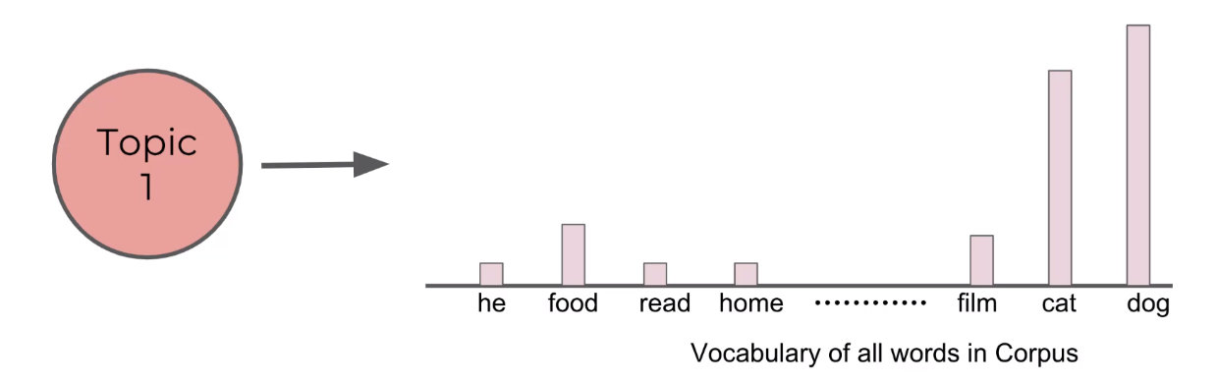
Topics themselves are probability distribution over words.

Slide 13
LDA represents documents as mixtures of topics that spit out words with certain probabilities.

Slide 14
It assumes that documents are produced in the following fashion:
Decide on the number of words N the documents will have.

Slide 15
It assumes that documents are produced in the following fashion:
Choose a topic mixture for the document (according to a Dirichlet distribution over a fixed set of K topics).
E.g. 60% business, 20% politics, 10% food

Slide 16
Generate each word in the document by:
First picking a topic according to the multinomial distribution that you sampled previously (60% business, 20% politics, 10% food

Slide 17
Generate each word in the document by:
Using the topic to generate the word itself (according to the topic’s multinomial distribution).
For example, if we selected the food topic, we might generate the word “apple” with 60% probability, “home” with 30% probability, and so on.

Slide 18
Assuming this generative model for a collection of documents, LDA then tries to backtrack from the documents to find a set of topics that are likely to have generated the collection.

Slide 19
Now imagine we have a set of documents.
We’ve chosen some fixed number of K topics to discover, and want to use LDA to learn the topic representation of each documents and the words associated to each topic.

Slide 20
Go through each document, and randomly assign each word in the document to one of the K topics.
This random assignment already gives you both topic representations of all the documents and word distributions of all the topics (note, these initial random topics won’t make sense).

Slide 21
Now we iterate over every word in every document to improve these topics.
For every word in every document and for each topic t we calculate:
p(topic t | document d) = the proportion of words in document d that are currently assigned to topic t

Slide 22
Now we iterate over every word in every document to improve these topics.
For every word in every document and for each topic t we calculate:
p(word w | topic t) = the proportion of assignments to topic t over all document that come from this word w

Slide 23
Reassign w a new topic, where we choose topic t with probability
p(topic t | document d) * p (word w | topic t)
This is essentially the probability that topic t generated word w

Slide 24
After repeating the previous step a large number of times, we eventually reach a roughly steady state where the assignments are acceptable.

Slide 25
At the end we have each document assigned to a topic.
We also can search for the words that have the highest probability of being assigned to a topic.

Slide 26
We end with an output such as:
Document assigned to Topic #4
Most common words (highest probability) for Topic #4:
[‘cat’,’vet’,’bird’,’dog’,…’food’,’home’]
It is up to the user to interpret these topics.

Slide 27
Model Implementation
Loading data
Data Cleaning
Phrase Modeling: Bi-grams and Tri-grams
Data transformation: Corpus and Dictionary
Base Model Performance
Final Model
Visualize Results

